Slide 1
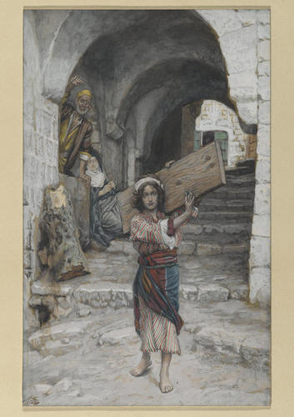

James Tissot
1836-1902 佛
The Life of Christ
The Youth of Jesus, 1886-94

Slide 2
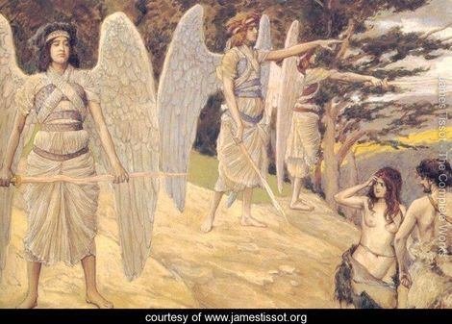
Adam and Eve Driven from Paradise

Slide 3
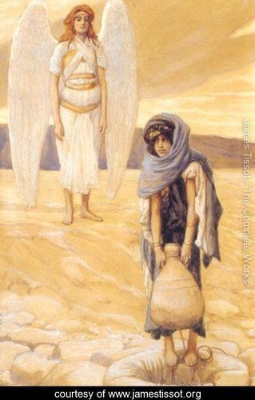
Hagar and the Angel in the Desert
1896-1900
Notes:
s

Slide 4
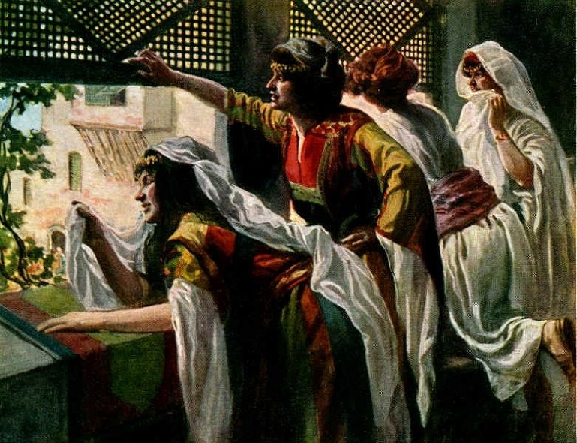
Michal Despises David

Slide 5
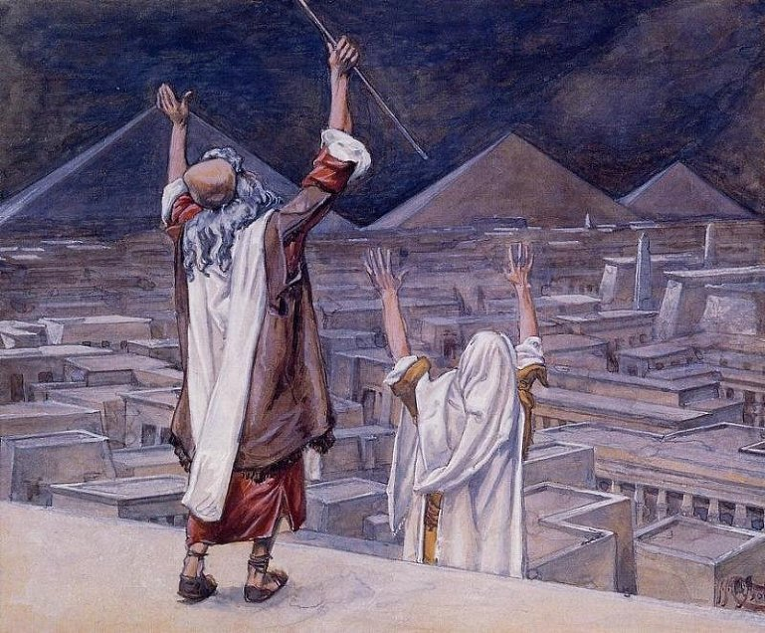
The Plague Of Locusts

Slide 6
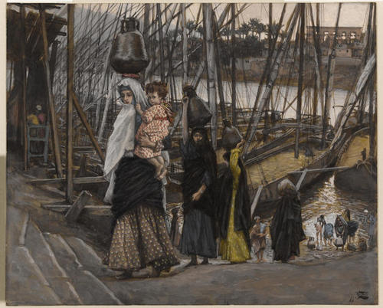
The Sojourn in Egypt, 1886-94

Slide 7
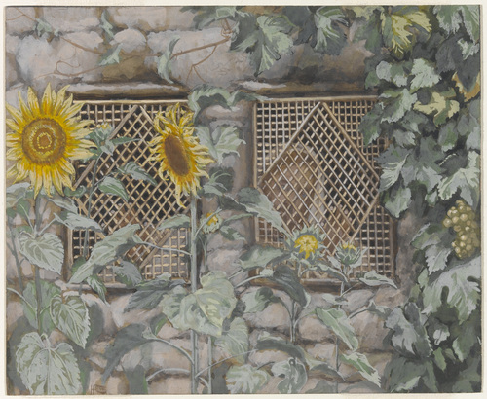
Jesus Looking through a Lattice, 1886-94

Slide 8
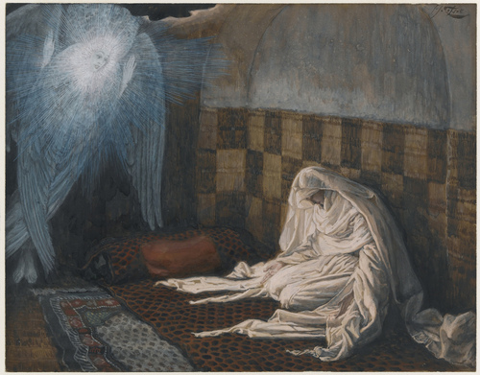
The Annunciation, 1886-94

Slide 9
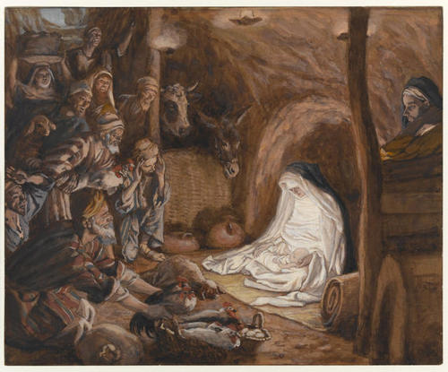
The Adoration of the Shepherds, 1886-94

Slide 10
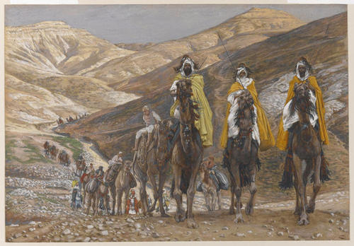
The Magi Journeying, 1886-94

Slide 11
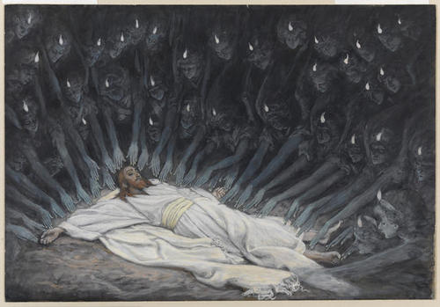
Jesus Ministered to by Angels, 1886-94

Slide 12
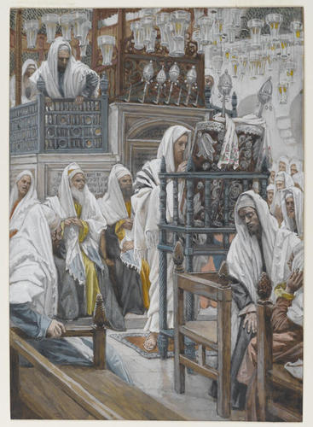
Jesus Unrolls the Book in the Synagogue, 1886-94

Slide 13
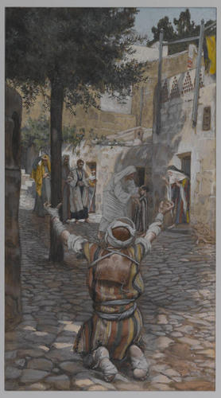
Healing of the Lepers at Capernaum, 1886-94

Slide 14
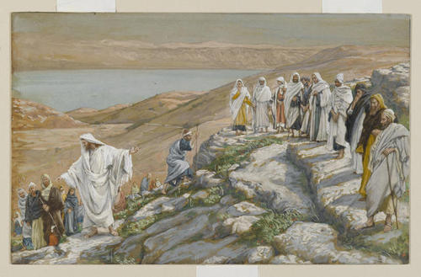
Ordaining of the Twelve Apostles, 1886-94

Slide 15
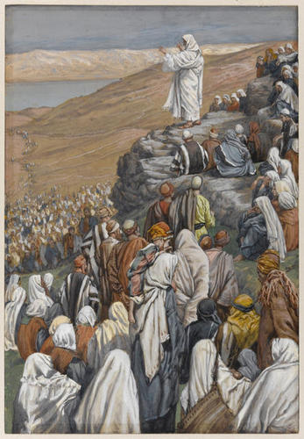
The Sermon of the Beatitudes,
1886-96

Slide 16
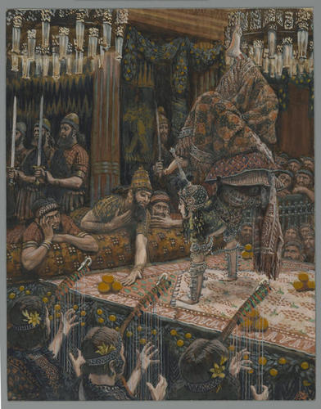
The Daughter of Herodias Dancing, 1886-96

Slide 17
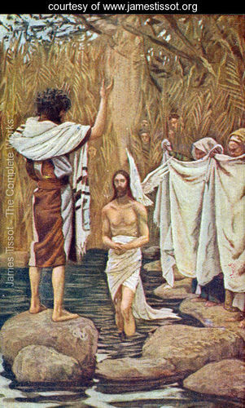
Baptism of Jesus
Notes:
B

Slide 18
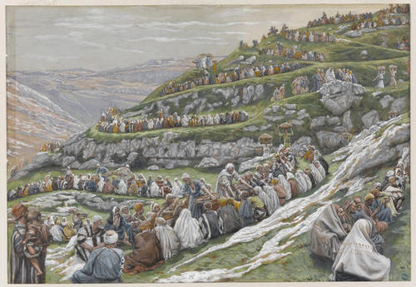
The Miracle of the Loaves and Fishes, 1886-96

Slide 19
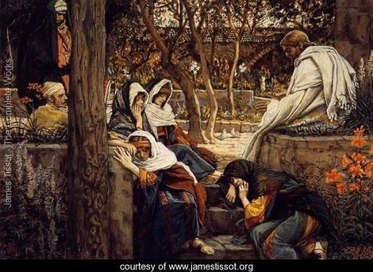
Jesus At Bethany

Slide 20
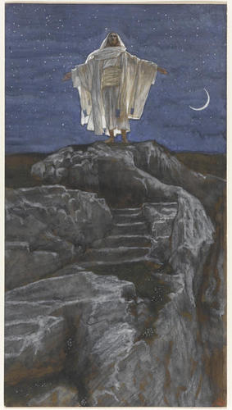
Jesus Goes Up Alone onto a Mountain to Pray, 1886-94

Slide 21
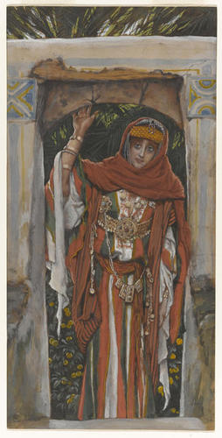
The Magdalene Before Her Conversion, 1886-94

Slide 22
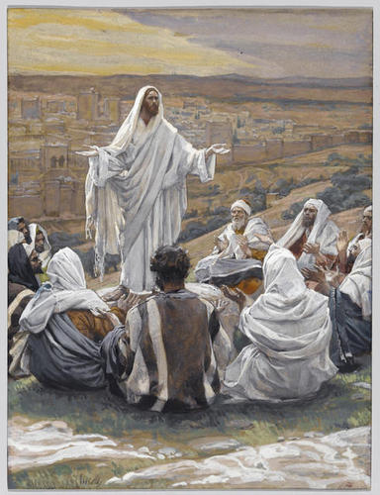
The Lord's Prayer, 1886-96

Slide 23
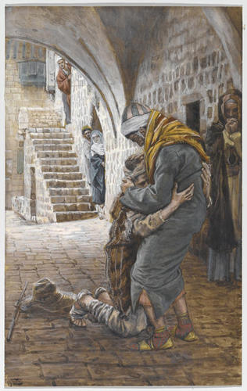
The Return of the Prodigal Son, 1886-94

Slide 24
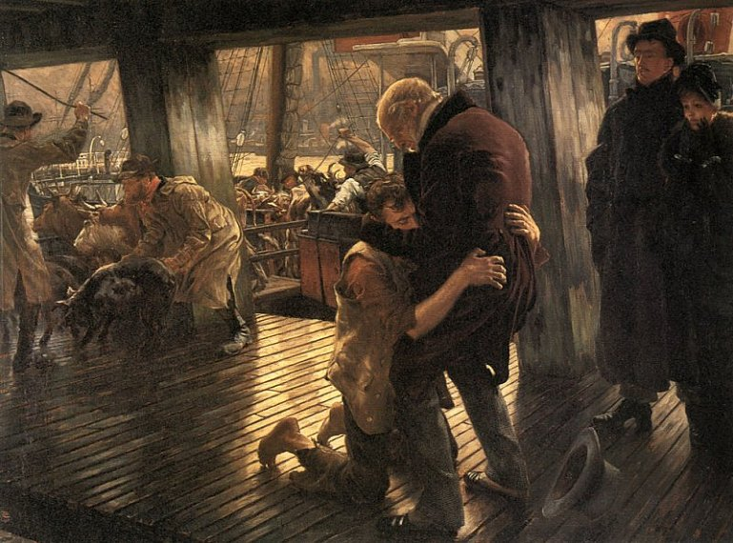
The Prodigal Son in Modern Life: The Return (1882)

Slide 25
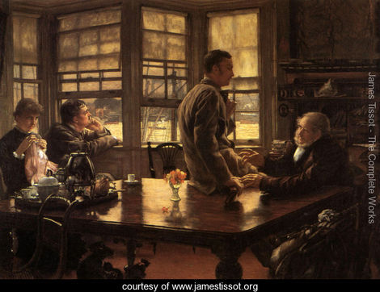
The Prodigal Son in Modern Life

Slide 26
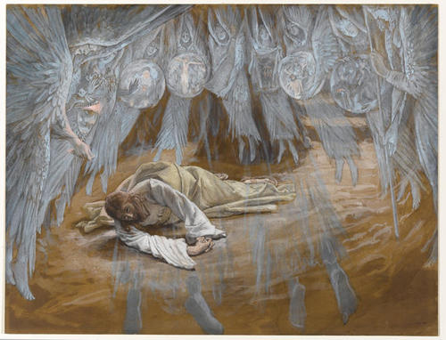
The Grotto of the Agony, 1886-94

Slide 27
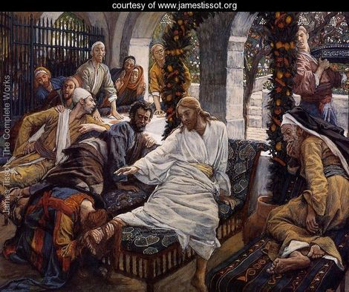
Mary Magdalene's Box of Very Precious Ointment

Slide 28
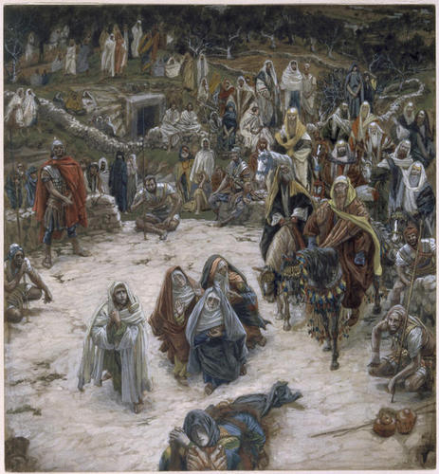
What Our Lord Saw from the Cross,
1886-94

